Slide 1

The Influence of Twitter Sentiment on Bitcoin Price Movements
CDS6344 – Social Media Computing
Faculty of Computing and Informatics,
MMU
Team Members:
Choo Chee Choong (1221302637)
Yap Weng Hong (1211103023)

Slide 2

Project Overview
Goal: Examine if Twitter sentiment influences Bitcoin price trends
Dataset: 4.8M+ tweets (2015–2025)
Tools: NLP, ML, DL, Transformer models
Key Focus: Is sentiment a leading/lagging indicator?

Slide 3

Problem Statement
Bitcoin is highly discussed on Twitter
Market reactions may reflect emotional tweets
Does public mood predict, follow, or align with price movements?
Study leverages a decade of tweet data to analyze this dynamic
Literature Review Highlights
(Bollen et al., 2011): Twitter mood correlates with stock market
(Ranco et al., 2015): Sentiment spikes during market events
ML, DL, Transformer models increasingly adopted
Gap: Few long-term studies with large datasets and visual insights

Slide 4

Methodology Overview
Data Preprocessing
Feature Engineering
Models Used
Normalization tokenization
stopword removal lemmatization
TF-IDF
GloVe
Contextual embeddings (DeBERTa)
Logistic Regression, SVM, BiLSTM, Hier-GCNN, BERT

Slide 5

01
Pretrained BERT sentiment pipeline
Sentiment Analysis Pipeline
Lexicon Models: VADER, TextBlob, Afinn
02
Output: Sentiment label + confidence
03
Stored for visual trends & comparison
04

Slide 6
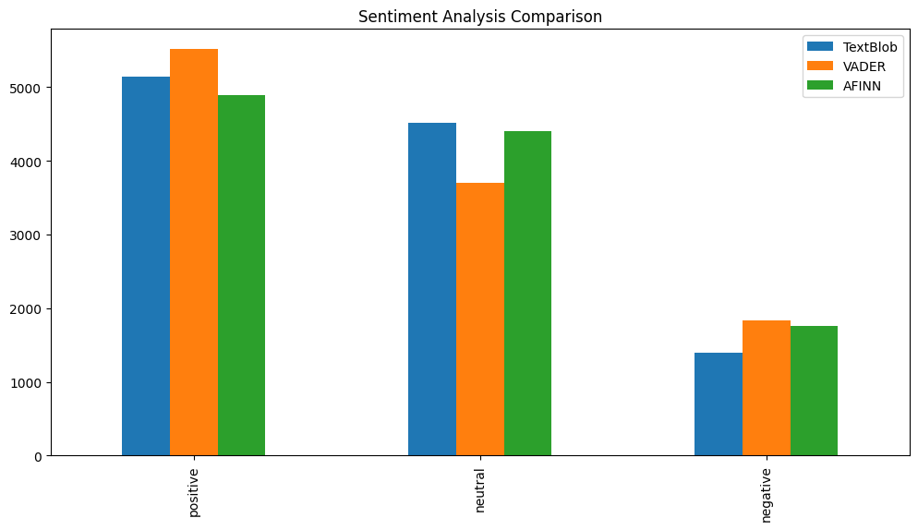

Slide 7
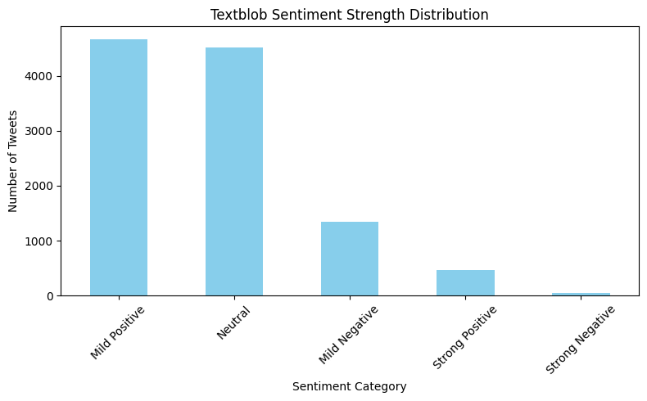

Slide 8
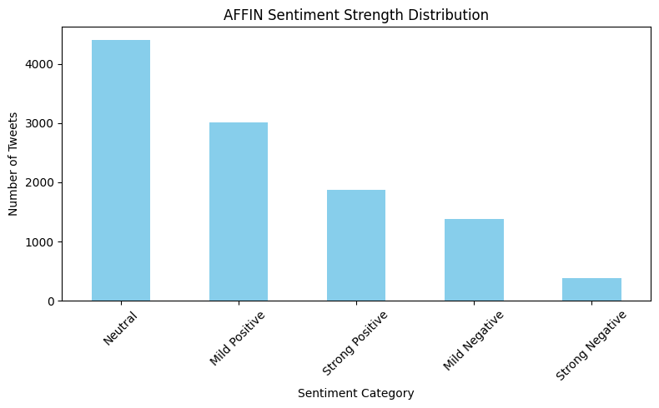

Slide 9



Model Architecture Overview
Machine Learning
Deep Learning
Transformer
Logistic Regression- Fast,, Interpretable
SVM- Handles Sparse Data
BiLSTM - Sequence Modelling
Hier-GCNN - Local.global text patterns
BERT(DeBERTa ABSA)
Contextual understanding

Slide 10
Evaluation Metrics
Accuracy
Precision
Recall
F1-Score
Confusion Matrix
Cross-Validation

Slide 11
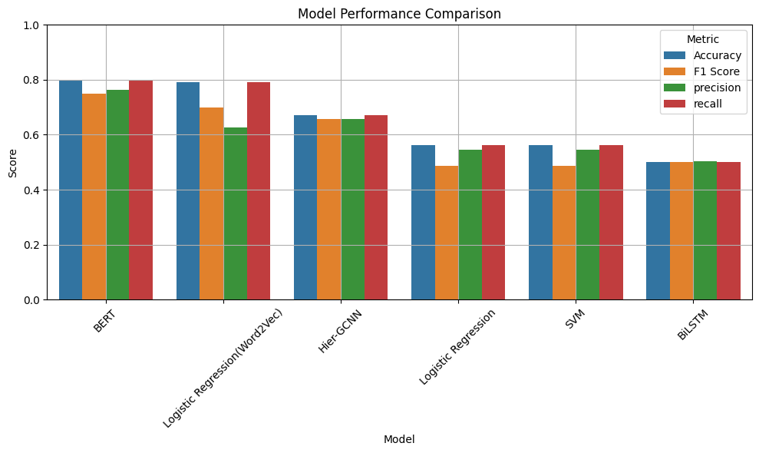
Result & Performance
Best Model: BERT (DeBERTa ABSA)
Accuracy
F1 Score
79.95%
0.75
Hier-GCNN showed strong precision
Word2Vec + Logistic Regression: good trade-off

Slide 12
Discussion
BERT outperforms all models
Word2Vec improves classical models
Hier-GCNN is a middle ground
Neutral sentiments hardest to classify
Transformer models excel in noisy text environments

Slide 13
Conclusion
Twitter sentiment correlates with Bitcoin price
BERT offers superior accuracy
ML can help anticipate crypto market shifts
NLP + Financial data = actionable insight

Slide 14
Future Work
Lag-Lead Analysis of sentiment vs. price
Expand to multi-emotion classification
Fine-tune BERT on financial corpora
Build real-time dashboards for live monitoring

Slide 15

THANK YOU!

